Slide 1

Android development preparation
REST Service
Presented by ARMS（THAILAND）Co., Ltd.

Slide 2
Index
Practical Web Development with Android Studio
Development preparation
Summary
  1-1. Objective
  1-2. HTTP Communication
  1-3. Rest calls
  1-4. JSON viewer
Create Rest Service
  2-1. App Summary
  2-2. Create Database
  2-3. Create a project
  2-4. Dependency
  2-5. Create entity class
  2-6. Create repository
  2-7. application.properties
  2-8. Create RestController
  2-9. Run your app
  2-10. RestTemplate

Slide 3
1. Summary
Practical Web Development with Android Studio
Development preparation
1-1. Objective
In this class, we will create a RESTful Service by using Spring boot
REST : REpresentational State Transfer
REST is an architectural style which can be used to build web services, that can be executed by various clients such as mobiles
Rather than using complex mechanisms to connect to other sources, simple HTTP is used to access those resources.
Here are some of the famous HTTP request,
  To retrieve resources : GET
  To create resources : POST
  To update resources : PUT
  To delete resources : DELETE
Continue on next page

Slide 4
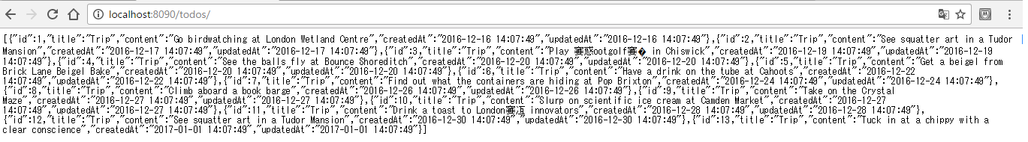
1. Summary
Practical Web Development with Android Studio
Development preparation
1-1. Objective
Instead of delivering in HTML, REST is a combination of presentation and data, and they are displayed by minimum format like JSON.
REST API can be created with Spring boot.
The reason we create this API is that this can be used for backend of android app to return request from android app.

Slide 5
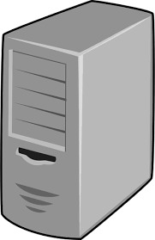

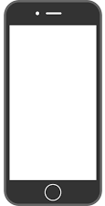


1. Summary
Practical Web Development with Android Studio
Development preparation
1-2. HTTP Communication
Basic http communication
Server
HTTP Request
Client
HTTP Response

Slide 6
1. Summary
Practical Web Development with Android Studio
Development preparation
1-2. HTTP Communication
Basic http communication
Browser
Server
HTTP Request
Browser, curl, retrofit
Client
HTTP Response
Spring API

Slide 7
1. Summary
Practical Web Development with Android Studio
Development preparation
1-2. HTTP Communication
Four verbs used in http request
Browser
Server
HTTP Request
Browser, curl, retrofit
  To retrieve resources : GET
  To create resources : POST
  To update resources : PUT
  To delete resources : DELETE
Client
HTTP Response
Spring API

Slide 8
1. Summary
Practical Web Development with Android Studio
Development preparation
1-2. HTTP Communication
Retrieve data from Server
Client
Server
HTTP Request
  To retrieve resources : GET
  To create resources : POST
  To update resources : PUT
  To delete resources : DELETE
HTTP Response
Spring API

Slide 9
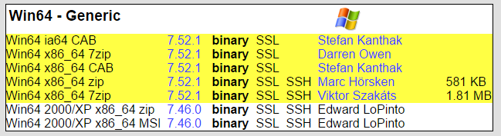
1. Summary
Practical Web Development with Android Studio
Development preparation
1-3. REST calls
In this section, we use cURL to send REST calls to Server
This will help you understand request and response between mobile client and server.
Go to the following page and download cURL
https://curl.haxx.se/download.html

Slide 10
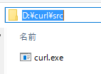
1. Summary
Practical Web Development with Android Studio
Development preparation
1-3. REST calls
Create curl folder in D drive
D:\curl\
Extract the downloaded file curl-7.52.1.zip
After extracting, you will have src folder.
Add D:\curl\src to your environment variable path, so you can use curl command from cmd.exe or gitbash
Run the following command to test curl, this will return JSON object
>curl https://api.github.com

Slide 11
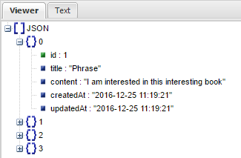
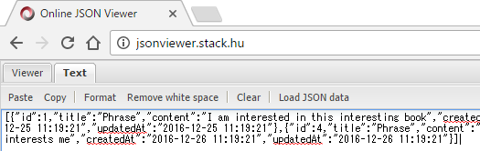
1. Summary
Practical Web Development with Android Studio
Development preparation
1-4. JSON viewer
When you have so many data, readability is very low, in other words, it is hard to see.
Easy way to increase readability of JSON format is to use “online JSON viewer. Go to the following site
http://jsonviewer.stack.hu/
You can paste JSON array(object) in Text tab and move to Viewer tab

Slide 12
2. Create Rest Service
Practical Web Development with Android Studio
Development preparation
2-1. App Summary
In this chapter, we create Rest API and Rest Client by using Spring boot
Previous chapter, we used cURL for Rest Client, the next chapter we will use Spring for Rest Client
Spring boot has a RestTemplate class which is designed to provide a simple way to send Rest calls to Rest API.
Rest Client (cURL)
Rest API (Spring boot)
Rest Client (Spring boot)
Rest API (Spring boot)
Rest Client (Android)
Rest API (Spring boot)

Slide 13
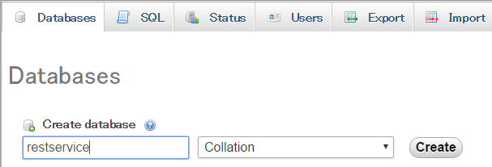

2. Create Rest Service
Practical Web Development with Android Studio
Development preparation
2-2. Create database
Go to phpMyAdmin Database tab and create a database “rsservice”.
rsservice
Click “Create”
Go to Import tab and select “user.sql”, this will create a user table.
Go to SQL tab and send in the following SQL to create dummy data
insert into user(id, name) values(1, 'John'),(2, 'Bob'),(3, 'Mike');

Slide 14
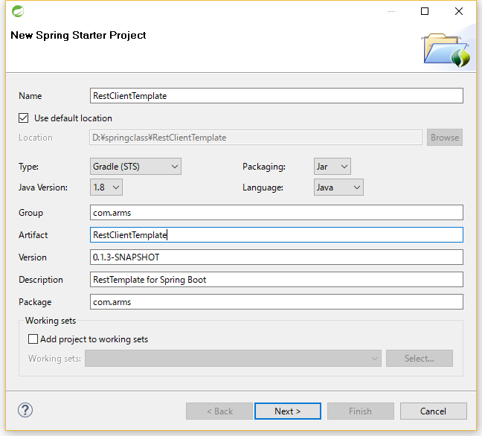
2. Create Rest Service
Practical Web Development with Android Studio
Development preparation
2-3. Create a project
Open STS, File – New – Spring Starter Project
Name : RestClientTemplate
Click Next >

Slide 15
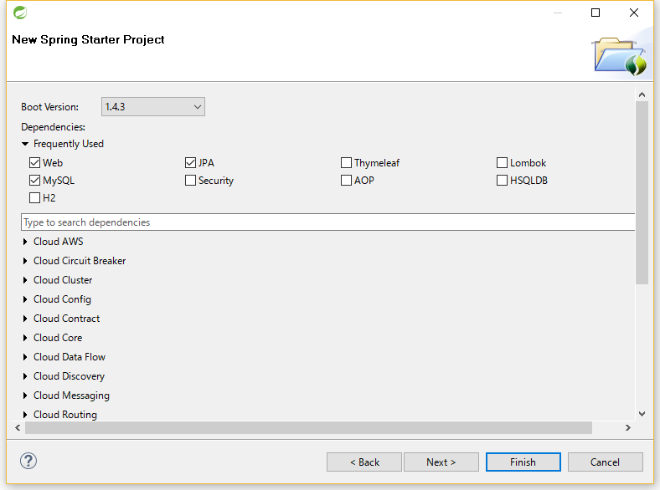
2. Create Rest Service
Practical Web Development with Android Studio
Development preparation
2-3. Create a project
Select “Depedencies”
▼Web
Web
▼SQL
JPA
MySQL
Click Next >

Slide 16
2. Create Rest Service
Practical Web Development with Android Studio
Development preparation
2-4. Dependency
Click finish, this will connect to Spring io page and create a project
It takes a while to create a project.
Once you created a project, right-click on the project and Gradle(STS) – Enable Dependency Management
Gradle(STS) – Refresh All

Slide 17

2. Create Rest Service
Practical Web Development with Android Studio
Development preparation
2-5. Create entity class
Right-click on “com.arms” package, create com.arms.domain.entity, and then create User.java
Create two fields, id and name in User class
package com.arms.domain.entity;
public class User {
private int id;
private String name;
}

Slide 18
2. Create Rest Service
Practical Web Development with Android Studio
Development preparation
2-5. Create entity class
Add @Entity, @Table, @Id, and @GeneratedValue
@Entity
@Table(name = "user")
public class User {
@Id
@GeneratedValue
private int id;
private String name;
}
@Entity
@Table
@Id
@GeneratedValue
Make sure to understand the meaning of each annotation

Slide 19
2. Create Rest Service
Practical Web Development with Android Studio
Development preparation
2-5. Create entity class
Create getters and setters for each field.
…………………………
private String name;
public int getId() {
return id;
}
public void setId(int id) {
this.id = id;
}
public String getName() {
return name;
}
public void setName(String name) {
this.name = name;
}
}
In Java, it’s always a good practice to make fields private, and access them through getters and setters.

Slide 20
2. Create Rest Service
Practical Web Development with Android Studio
Development preparation
2-5. Create entity class
Create three constructers
…………………………
private String name;
public User(int id, String name) {
this.id = id;
this.name = name;
}
public User(String name) {
this.name = name;
}
public User() {
}
…………………………
}
The one with all arguments, the others with no argument and one argument

Slide 21
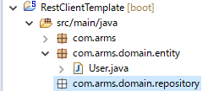
2. Create Rest Service
Practical Web Development with Android Studio
Development preparation
2-6. Create repository
Create Repository interface to access database
Last time we created a project - model(entity), DAO, Controller pattern.
This time we will create a project - Repository, entity, (service), Controller pattern. We can still create DAO, but in many cases, spring custom repository is good enough to work as a DAO.
Create “com.arms.domain.repository” package

Slide 22
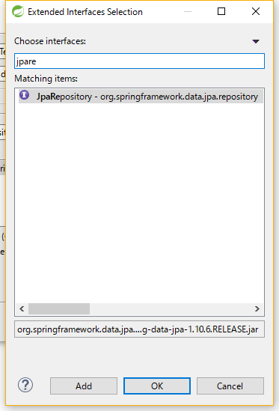
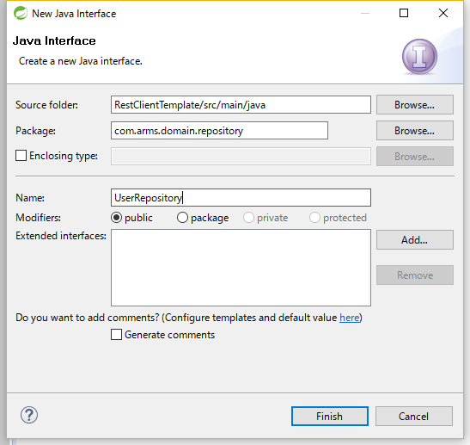
2. Create Rest Service
Practical Web Development with Android Studio
Development preparation
2-6. Create repository
Create UserRepository interface under “com.arms.domain.repository” package
Add JpaRepository to extend

Slide 23
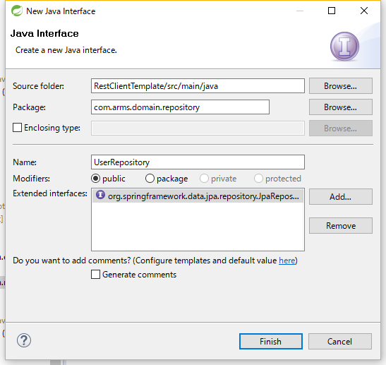
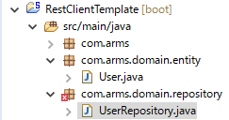
2. Create Rest Service
Practical Web Development with Android Studio
Development preparation
2-6. Create repository
Create UserRepository interface under “com.arms.domain.repository” package
UserRepository

Slide 24
2. Create Rest Service
Practical Web Development with Android Studio
Development preparation
2-6. Create repository
Create UserRepository interface under “com.arms.domain.repository” package
package com.arms.domain.repository;
import org.springframework.data.jpa.repository.JpaRepository;
import org.springframework.stereotype.Repository;
import com.arms.domain.entity.User;
@Repository
public interface UserRepository extends JpaRepository<User, Integer> {
}
@Repository
JpaRepository<Entity class type, primary key field> this tells that which Database to access.

Slide 25
2. Create Rest Service
Practical Web Development with Android Studio
Development preparation
2-7. application.properties
Open application.properties to add database connection setting
spring.datasource.url=jdbc:mysql://192.168.33.10:3306/rsservice?useUnicode=true&characterEncoding=UTF-8&zeroDateTimeBehavior=convertToNull
spring.datasource.username=root
spring.datasource.password=manager
3306 is a port number for mysql.
rsservice: database you want to connect.
username: mysql database user
password: the above user password

Slide 26
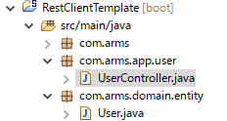
2. Create Rest Service
Practical Web Development with Android Studio
Development preparation
2-8. Create RestController
Create “com.arms.app.user” package, and then create UserController under it.
package com.arms.app.user;
import java.util.List;
import org.springframework.beans.factory.annotation.Autowired;
import org.springframework.web.bind.annotation.RequestMapping;
import org.springframework.web.bind.annotation.RestController;
import com.arms.domain.entity.User;
import com.arms.domain.repository.UserRepository;
@RestController
public class UserController {

Slide 27
2. Create Rest Service
Practical Web Development with Android Studio
Development preparation
2-8. Create RestController
Create “com.arms.app.user” package, and then create UserController under it.
@Autowired
UserRepository userRepository;
@RequestMapping("todos")
public List<User> list(){
return userRepository.findAll();
}
}
@RestController =? @Controller + @ResponseBody
This controller will return object or object data HTTP respsonse like JSON/XML rather than View

Slide 28
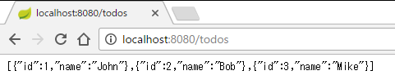
2. Create Rest Service
Practical Web Development with Android Studio
Development preparation
2-9. Run your app
Run your application and access http://localhost:8080/todos
You can see all user table data as a JSON array format

Slide 29
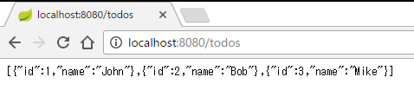
2. Create Rest Service
Practical Web Development with Android Studio
Development preparation
2-9. Run your app
Continue from the last document
Last time we created Rest API to return JSON format
This time will create Rest Client to send Rest calls by using Spring boot
Rest API (spring boot)
Rest Client (spring boot)
Rest API (spring boot9

Slide 30
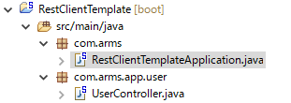
2. Create Rest Service
Practical Web Development with Android Studio
Development preparation
2-10. RestTemplate
Open STS and go to RestClientTemplate project, in which you have RestClientTemplateApplication
@SpringBootApplication = @Configuration + @EnableAutoConfiguration + @ComponentScan
http://docs.spring.io/autorepo/docs/spring-boot/current/reference/html/using-boot-using-springbootapplication-annotation.html
@ComponentScan
http://docs.spring.io/autorepo/docs/spring-boot/current/reference/html/using-boot-spring-beans-and-dependency-injection.html
@Configuration + @EnableAutoConfiguration
http://docs.spring.io/autorepo/docs/spring-boot/current/reference/html/using-boot-auto-configuration.html

Slide 31
2. Create Rest Service
Practical Web Development with Android Studio
Development preparation
2-10. RestTemplate
RestClientTemplateApplication class has a main method.
main method is the first method to be called when your java application is run.
SpringApplication is used to bootstrap your application.
Add the following code in the main method to create a REST call to access REST API
public static void main(String[] args) {
SpringApplication.run(RestService2Application.class, args);
final String uri = "http://localhost:8080/todos";
Define base_url which Rest client access.

Slide 32
2. Create Rest Service
Practical Web Development with Android Studio
Development preparation
2-10. RestTemplate
Create an instance of RestTemplate class
public static void main(String[] args) {
SpringApplication.run(RestService2Application.class, args);
final String uri = "http://localhost:8080/todos";
RestTemplate restTemplate = new RestTemplate();
RestTemplate class is used for client-side HTTP access

Slide 33
2. Create Rest Service
Practical Web Development with Android Studio
Development preparation
2-10. RestTemplate
Call getForEntity method in RestTemplate class
public static void main(String[] args) {
SpringApplication.run(RestService2Application.class, args);
final String uri = "http://localhost:8080/todos";
RestTemplate restTemplate = new RestTemplate();
ResponseEntity<String> listResponse = restTemplate.getForEntity(uri, String.class);
geForEntity in this code will send a GET request to the specified url with String, and store an entity as ResponseEntity

Slide 34
2. Create Rest Service
Practical Web Development with Android Studio
Development preparation
2-10. RestTemplate
Add the following line to display the result of Rest call and Response from API
@SpringBootApplication
public class RestClientTemplateApplication {
public static void main(String[] args) {
SpringApplication.run(RestClientTemplateApplication.class, args);
final String uri = "http://localhost:8080/todos";
RestTemplate restTemplate = new RestTemplate();
ResponseEntity<String> listResponse = restTemplate.getForEntity(uri, String.class);
System.out.println(listResponse);
}
}

Slide 35
2. Create Rest Service
Practical Web Development with Android Studio
Development preparation
2-10. RestTemplate
Run your application and see if the result is displayed in console
When you see the end line of console,
“http status code”, “Body(ResponseBody)”, “http header” information in the ResponseEntity are displayed
<200 OK,[{"id":1,"name":"John"},{"id":2,"name":"Bob"},{"id":3,"name":"Mike"}],{Content-Type=[application/json;charset=UTF-8], Transfer-Encoding=[chunked], Date=[Wed, 28 Dec 2016 09:39:01 GMT]}>

Slide 36
2. Create Rest Service
Practical Web Development with Android Studio
Development preparation
2-10. RestTemplate
You can also display http response as log info in the console
package com.arms;
import org.slf4j.Logger;
import org.slf4j.LoggerFactory;
import org.springframework.boot.SpringApplication;
import org.springframework.boot.autoconfigure.SpringBootApplication;
import org.springframework.http.ResponseEntity;
import org.springframework.web.client.RestTemplate;
@SpringBootApplication
public class RestClientTemplateApplication {
public static final Logger log = LoggerFactory.getLogger(RestClientTemplateApplication.class);
public static void main(String[] args) {
SpringApplication.run(RestClientTemplateApplication.class, args);
final String uri = "http://localhost:8080/todos";
RestTemplate restTemplate = new RestTemplate();
ResponseEntity<String> listResponse = restTemplate.getForEntity(uri, String.class);
log.info(listResponse.getBody());
}
}

Slide 37


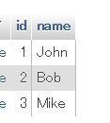
2. Create Rest Service
Practical Web Development with Android Studio
Development preparation
2-10. RestTemplate
Restart your app and see the console
INFO[0;39m [35m13032[0;39m [2m---[0;39m [2m[ main][0;39m [36mcom.arms.RestClientTemplateApplication [0;39m [2m:[0;39m [{"id":1,"name":"John"},{"id":2,"name":"Bob"},{"id":3,"name":"Mike"}]
log.info(listResponse.getBody());
This time retrieves http response body by using getBody() method
Now you have successfully sent the Rest call from Spring Client to Spring API
REST Client
REST API

Slide 38
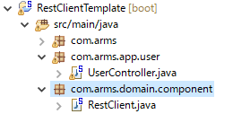
2. Create Rest Service
Practical Web Development with Android Studio
Development preparation
2-10. RestTemplate
This time retrieves user data in a different way, create component package and RestClient class
com.arms.domain.component
RestClient.java
Set @Component annotation and bean name, and then create a static field
@Component("rsClnt")
public class RestClient {
static final String uri = "http://localhost:8080/todos";

Slide 39
2. Create Rest Service
Practical Web Development with Android Studio
Development preparation
2-10. RestTemplate
Create a method to rest call (GET) to a specified uri String.
@Component("rsClnt")
public class RestClient {
static final String uri = "http://localhost:8080/todos";
@Autowired
private RestTemplate restTemplate;
public String getAllUsers(){
return restTemplate.getForObject(uri, String.class);
}
…………………………………………………
RestTemplate provides client-side HTTP access
In this case, retrieves an expression by GET request on the specified URL String

Slide 40
2. Create Rest Service
Practical Web Development with Android Studio
Development preparation
2-10. RestTemplate
Go to RestClientTemplateApplication.java and delete the previous code
@SpringBootApplication
public class RestClientTemplateApplication {
public static void main(String[] args) {
ApplicationContext appContext = SpringApplication.run(RestClientTemplateApplication.class, args);
}
}
This run method returns an instance of ApplicationContext, but when you want to customize the default values, add “ApplicationContext appContext = “.

Slide 41
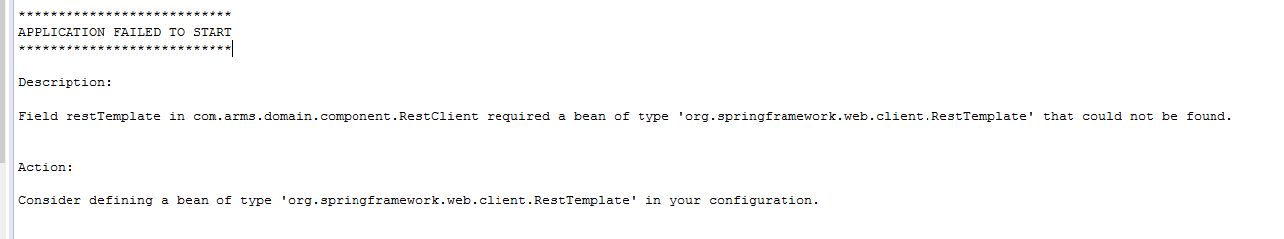
2. Create Rest Service
Practical Web Development with Android Studio
Development preparation
2-10. RestTemplate
Add the following line and display a rest call result in the console
@SpringBootApplication
public class RestClientTemplateApplication {
public static void main(String[] args) {
ApplicationContext appContext = SpringApplication.run(RestClientTemplateApplication.class, args);
System.out.println(((RestClient)appContext.getBean("rsClnt")).getAllUsers());
}
}
Restart your app and see the result of the rest call ( response )
But…you get an error like below,

Slide 42

2. Create Rest Service
Practical Web Development with Android Studio
Development preparation
2-10. RestTemplate
The error indicates that you need a bean of RestTemplate, and have to define
Create com.arms.config package and RestClientConfig class
package com.arms.config;
import org.springframework.context.annotation.Bean;
import org.springframework.web.client.RestTemplate;
public class RestClientConfig {
@Bean
public RestTemplate getRestTemplate() {
return new RestTemplate();
}
}
The @Bean annotation returns an object that spring should register as bean in application context.

Slide 43
2. Create Rest Service
Practical Web Development with Android Studio
Development preparation
2-10. RestTemplate
Restart your app and see the result of the rest call ( response ) in your console
But you still have the same error, you have to add @Configuration
package com.arms.config;
import org.springframework.context.annotation.Bean;
import org.springframework.context.annotation.Configuration;
import org.springframework.web.client.RestTemplate;
@Configuration
public class RestClientConfig {
@Bean
public RestTemplate getRestTemplate() {
return new RestTemplate();
}
}
The @Bean annotation returns an object that spring should register as bean in application context(DI container).
Restart your app and see the result of the rest call ( response ) in your console

Slide 44
2. Create Rest Service
Practical Web Development with Android Studio
Development preparation
2-10. RestTemplate(DI)
Let’s think about DI, one Java class has a dependency on another class, if it uses an instance of this class.
Conventional way to create an instance of RestTemplate by new Operator
@Component("rsClnt")
public class RestClient {
static final String uri = "http://localhost:8080/todos";
private RestTemplate restTemplate;
public String getAllUsers(){
restTemplate = new RestTemplate();
return restTemplate.getForObject(uri, String.class);
}
}
Without injecting the RestTemplate bean, RestCilent class has a dependency on RestTemplate class.

Slide 45
2. Create Rest Service
Practical Web Development with Android Studio
Development preparation
2-10. RestTemplate(DI)
RestTemplate bean is already injected, but using new Operator to create an instance.
Conventional way to create an instance of RestTemplate by new Operator
And unnecessary code….
@Component("rsClnt")
public class RestClient {
static final String uri = "http://localhost:8080/todos";
@Autowired
private RestTemplate restTemplate;
public String getAllUsers(){
restTemplate = new RestTemplate();
return restTemplate.getForObject(uri, String.class);
}
}
Java classes should be as independent as possible from other Java classes.

Slide 46
2. Create Rest Service
Practical Web Development with Android Studio
Development preparation
2-10. RestTemplate(DI)
To avoid this, inject an interface and create a loose coupling code.
Use RestOperations interface to avoid creating an instance by “new” operator.
@Component("rsClnt")
public class RestClient {
static final String uri = "http://localhost:8080/todos";
@Autowired
private RestOperations restOperations;
public String getAllUsers(){
return restOperations.getForObject(uri, String.class);
}
}
This code will be used

Slide 47
2. Create Rest Service
Practical Web Development with Android Studio
Development preparation
2-10. RestTemplate
Send a rest call (POST) to Rest API, and create a user
Go to UserController and create a POST method
@RequestMapping("todos")
public List<User> list(){
return userRepository.findAll();
}
@RequestMapping(value = "todos", method = RequestMethod.POST)
public ResponseEntity<User> createUser(@RequestBody User user){
userRepository.save(user);
return new ResponseEntity<User>(user, HttpStatus.CREATED);
}
This controller method will return ResponseBody, http status and etc…
RequestBody will convert JSON to Java object.

Slide 48
1. Create Rest Client
Practical Web Development with Android Studio
Development preparation
2-10. RestTemplate
Go to RestClient.java and add a rest call (POST) to it
public String getAllUsers(){
return restOperations.getForObject(uri, String.class);
}
public User createUser(){
User user = new User("Your name");
return restOperations.postForObject( uri, user, User.class);
}
Calling a constructor with user name field, and sending a user object to the specified URL.
postForObject( uri, user, User.class)
Create a new user by POSTing, the given object “User.class user object” to URL

Slide 49
2. Create Rest Service
Practical Web Development with Android Studio
Development preparation
2-10. RestTemplate
Go to RestClientTemplateApplication.java and add the following line, and call the method and display the response in the console
@SpringBootApplication
public class RestClientTemplateApplication {
public static void main(String[] args) {
ApplicationContext appContext = SpringApplication.run(RestClientTemplateApplication.class, args);
System.out.println(((RestClient)appContext.getBean("rsClnt")).getAllUsers());
System.out.println(((RestClient)appContext.getBean("rsClnt")).createUser());
Restart your app and see the response
Result is not understandable, because toString is not overriden.

Slide 50
2. Create Rest Service
Practical Web Development with Android Studio
Development preparation
2-10. RestTemplate
If you don’t override toString() method, Java normally returns the Object class toString() which is not suitable for returning a user object. It is a good practice and recommended to override toString() for sub class
Go to User.java and override toString()
public void setName(String name) {
this.name = name;
}
@Override
public String toString() {
return "User [id=" + id + ", name=" + name + "]";
}
Restart your app and see the response again.

Slide 51
2. Create Rest Service
Practical Web Development with Android Studio
Development preparation
2-10. RestTemplate
This time, send a rest call (PUT) to REST API, and update a user
Go to UserController.java and add a method to respond to PUT request.
@RequestMapping(value = "todos", method = RequestMethod.POST)
public ResponseEntity<User> createUser(@RequestBody User user){
userRepository.save(user);
return new ResponseEntity<User>(user, HttpStatus.CREATED);
}
@RequestMapping(value = "todos/{id}", method = RequestMethod.PUT)
public ResponseEntity<User> updUser(@PathVariable("id") int id, @RequestBody User user){
userRepository.save(user);
return new ResponseEntity<User>(user, HttpStatus.OK);
}
This time, has to find a user by id

Slide 52
2. Create Rest Service
Practical Web Development with Android Studio
Development preparation
2-10. RestTemplate
Go to RestClient.java and add a rest call (PUT) to it
public User createUser(){
User user = new User("Your name");
return restOperations.postForObject( uri, user, User.class);
}
public User updateUser(){
Map<String, Integer> vars = new HashMap<String, Integer>();
vars.put("id",15);
}
Create a updateUser() method and Map object in it.
Put data into vars(Map object) as a key and value
Map value has to be an existing id number

Slide 53
2. Create Rest Service
Practical Web Development with Android Studio
Development preparation
2-10. RestTemplate
Go to RestClient.java and add a rest call (PUT) to it
public User updateUser(){
Map<String, Integer> vars = new HashMap<String, Integer>();
vars.put("id",15);
User user = new User(vars.get("id"),"New name");
}
Call a constructor with id and name, create a user object. Get user id from Map object. This id(key) will be replaced by value (15)
Put data into vars(Map object) as a key and value

Slide 54
2. Create Rest Service
Practical Web Development with Android Studio
Development preparation
2-10. RestTemplate
Go to RestClient.java and add a rest call (PUT) to it
public User updateUser(){
Map<String, Integer> vars = new HashMap<String, Integer>();
vars.put("id",15);
User user = new User(vars.get("id"),"New name");
restOperations.put(uri + "/{id}", user, vars);
return user;
}
put(String url, Object request, Map<String,?> urlVariables)

Slide 55

2. Create Rest Service
Practical Web Development with Android Studio
Development preparation
2-10. RestTemplate
Go to RestClientTemplateApplication, add the following line
public static void main(String[] args) {
ApplicationContext appContext = SpringApplication.run(RestClientTemplateApplication.class, args);
System.out.println(((RestClient)appContext.getBean("rsClnt")).getAllUsers());
System.out.println(((RestClient)appContext.getBean("rsClnt")).createUser());
System.out.println(((RestClient)appContext.getBean("rsClnt")).updateUser());
}
Restart your app and see if the specified id’s user name is updated
MySQL user table

Slide 56
2. Create Rest Service
Practical Web Development with Android Studio
Development preparation
2-10. RestTemplate
Go to UserController and create a method Delete
@RequestMapping(value = "todos/{id}", method = RequestMethod.DELETE)
public ResponseEntity<String> deleteUser(@PathVariable("id") int id){
userRepository.delete(id);
return new ResponseEntity<String>(HttpStatus.OK);
}
This time, detele a user by id

Slide 57
2. Create Rest Service
Practical Web Development with Android Studio
Development preparation
2-10. RestTemplate
Go to RestClient and create a method deleteUser
public RestTemplate updateUser(){
Map<String, Integer> vars = new HashMap<String, Integer>();
vars.put("id",3);
User user = new User(vars.get("id"),"New name");
restTemplate.put(uri + "/{id}", user, vars);
return restTemplate;
}
public String deleteUser(){
Map<String, String> vars = new HashMap<String, String>();
vars.put("id", "20");
restOperations.delete(uri + "/{id}", vars);
return "user id:" + vars.get("id") + " is deleted." ;
}
Make sure to set the existing value for a Map object

Slide 58
2. Create Rest Service
Practical Web Development with Android Studio
Development preparation
2-10. RestTemplate
Go to RestClientTemplateApplication.java and add the following code
public static void main(String[] args) {
ApplicationContext appContext = SpringApplication.run(RestClientTemplateApplication.class, args);
System.out.println(((RestClient)appContext.getBean("rsClnt")).getAllUsers());
System.out.println(((RestClient)appContext.getBean("rsClnt")).createUser());
System.out.println(((RestClient)appContext.getBean("rsClnt")).updateUser());
System.out.println(((RestClient)appContext.getBean("rsClnt")).deleteUser());
}
Restart your app and see if the specified id’s user is deleted
Now that you can create a Rest Client and Rest API with Spring

Slide 59

Your Idea Leads Your Ideals
homepage: http://arms-asia.com/
facebook: https://www.facebook.com/arms.asia?fref=ts

